Slide 1
2016 Nonroad Collaborative Work Group
27 June 2019
Local Conference Lines:
Main line: 202-991-0477
EPA Region 1 (Boston): 857-702-8290 EPA Region 2 (NYC): 347-384-7287
EPA Region 3 (Philadelphia): 484-352-3221 EPA Region 4 (Atlanta): 470-705-2279
EPA Region 5 (Chicago): 312-667-7115 EPA Region 6 (Dallas): 469-250-2701
EPA Region 7 (Kansas City): 913-608-8349 EPA Region 8 (Denver): 720-642-6536
EPA Region 9 (San Francisco): 628-246-1294 EPA Region 10 (Seattle): 206-800-4483
EPA RTP (Raleigh): 984-444-7480
Conference ID: 6926578

Slide 2
Meeting Agenda
Review of 2016v1 Results for Calendar Year 2016
2016v1 Run Set-Up
National Emission Summaries by Equipment Sector
Total County-Level Emissions (NOx, VOC, PM2.5)
County-Level Emissions by Equipment Sector
Discussion/Next steps/Reminders

Slide 3
2016v1 Run Set-Up
Reviewed data submitted for 2017 NEI and incorporated into 2016v1 where appropriate, for example:
Month and spatial allocations of snowmobiles in Utah
Recreational marine allocations in Washington
Updated equipment populations in Texas, Maricopa County (AZ), Utah, Connecticut
Temporal (weekend/weekday and month) activity profiles and equipment types in Texas
Updated Georgia and Utah fuel supplies
Updated Agricultural and Construction equipment allocations to the state- and county-level (Work Group update)
Temporal (month) profiles for Agricultural equipment activity in LADCO states (Illinois, Indiana, Iowa, Michigan, Minnesota, Missouri, Ohio, Wisconsin)
Note: Texas provided 2016 nonroad emissions calculated with their TexN tool. EPA is working on incorporating these emissions into 2016v1. TCEQ will also supply TexN-generated emissions for future years. For more information on this tool, please see Chris Kite’s presentation to this work group (April 2018).

Slide 4
2016v1 Results: Emission Summaries by Sector
Differences between beta and v1 runs are attributable to state-supplied data and work group’s update to allocation of Construction and Agricultural equipment
Reminder: beta inventory was run ‘off-the-shelf’ (no changes to model defaults)
Notes: emissions from Airport Support and Oil Field Equipment are excluded from nonroad inventories.
Above summaries include Puerto Rico and U.S. Virgin Islands.

Slide 5
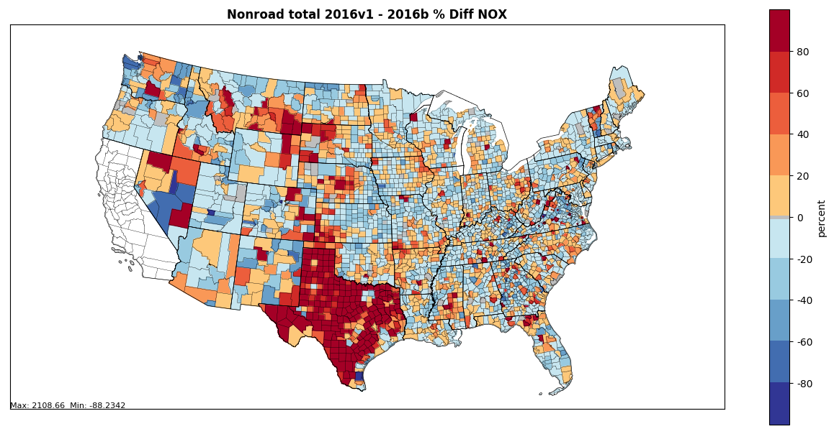
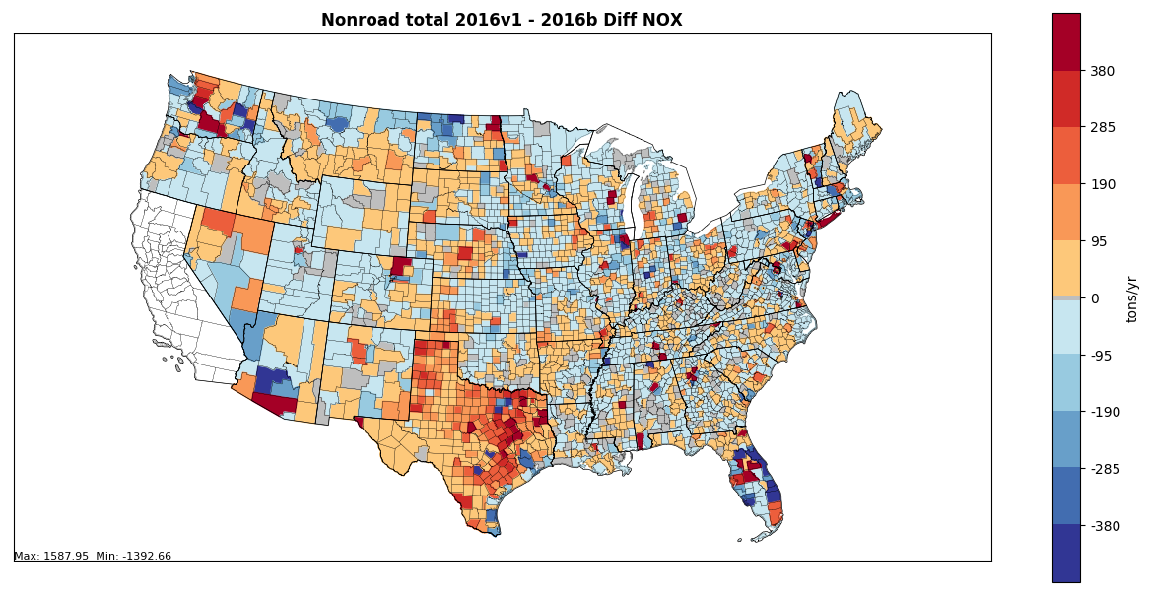
2016v1 Results: Total County-Level Emissions (NOx)
All Nonroad Equipment Sectors
Difference (tons/year): 2016v1 – 2016beta (below)
Percent difference: 2016v1 - 2016beta (right)

Slide 6
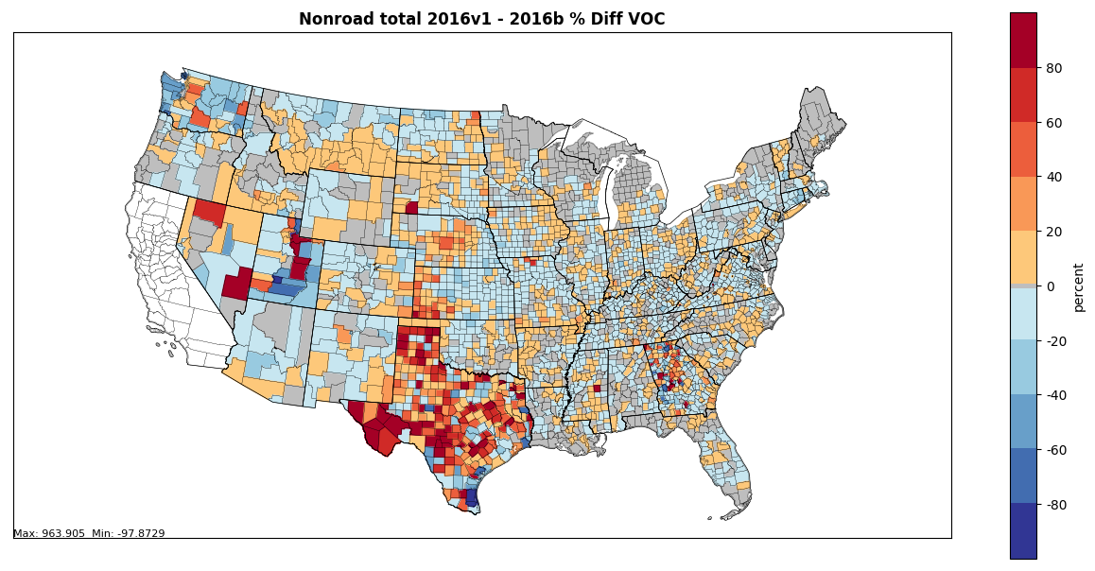
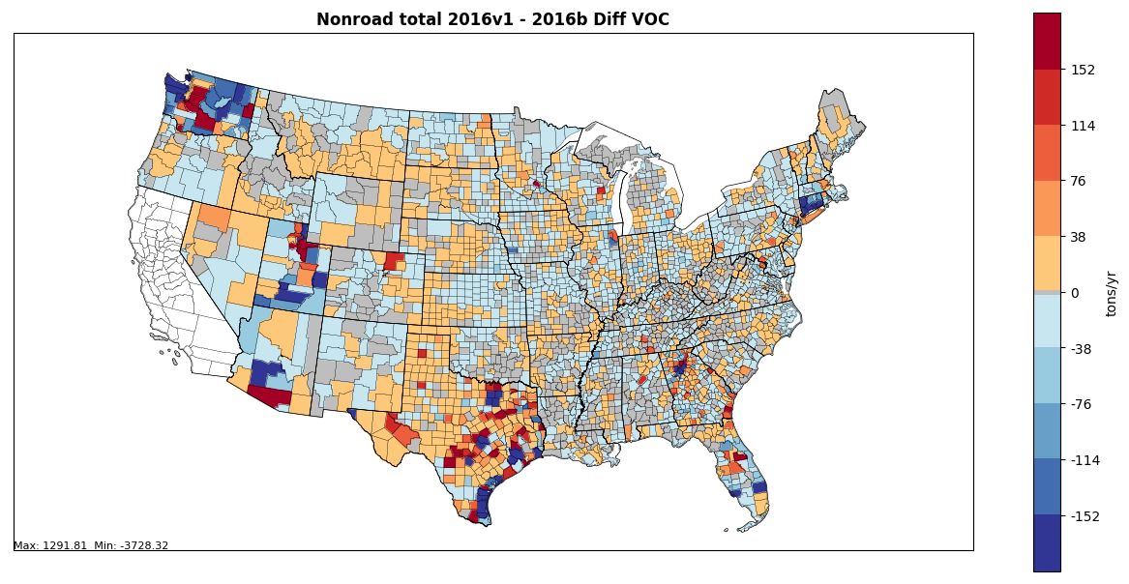
2016v1 Results: Total County-Level Emissions (VOC)
All Sectors
Difference (tons/year): 2016v1 – 2016beta (below)
Percent difference: 2016v1 - 2016beta (right)

Slide 7
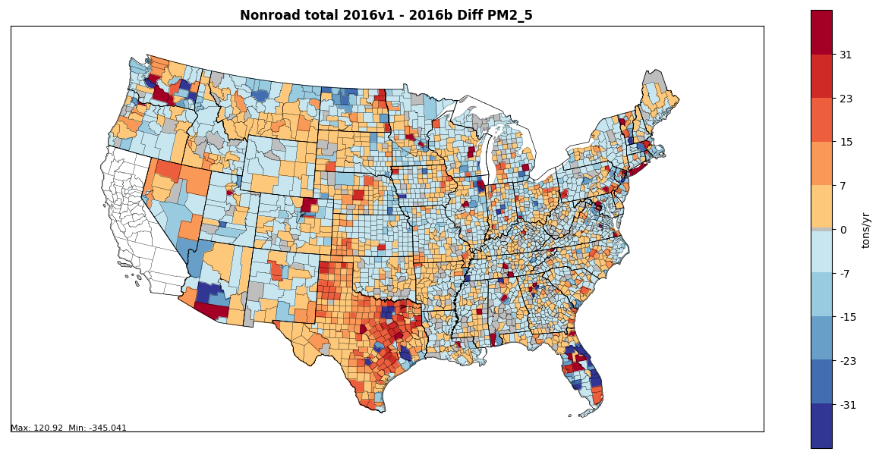
2016v1 Results: Total County-Level Emissions (PM2.5)
All Sectors
Difference (tons/year): 2016v1 – 2016beta (below)
Percent difference: 2016v1 - 2016beta (right)

Slide 8
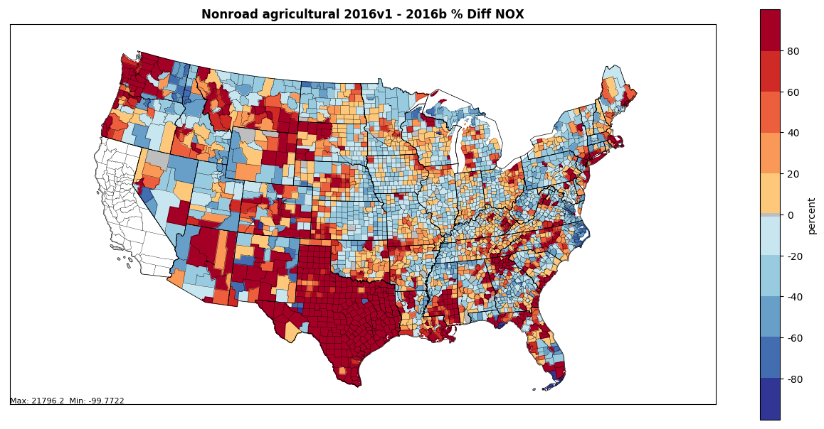
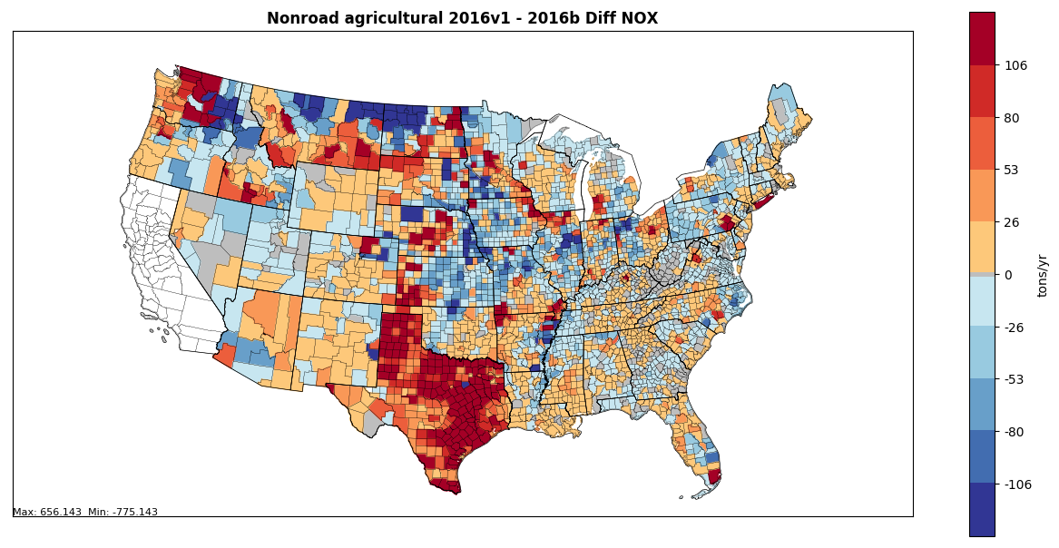
2016v1 Results: County-Level Emissions by Sector
Agricultural Sector
Difference (tons/year): 2016v1 – 2016beta (below)
Percent difference: 2016v1 - 2016beta (right)
Includes:
Updated equipment allocations (state- and county-level)
Updated temporal profiles for LADCO states, Texas
Updated equipment populations for Texas
Updated fuel formulation in Utah (still QAing) and Georgia

Slide 9
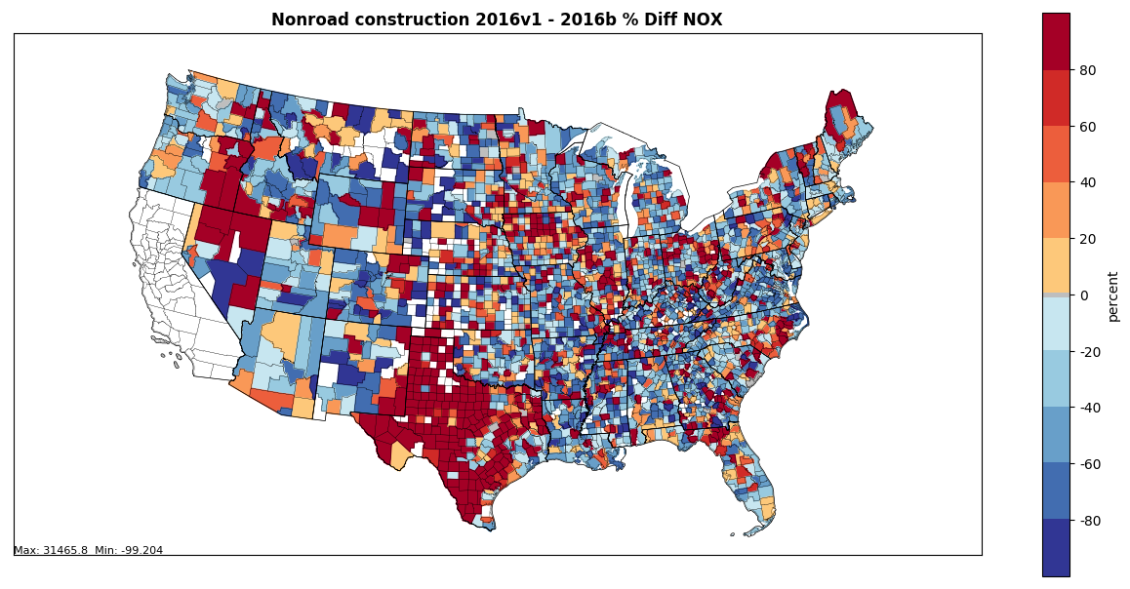
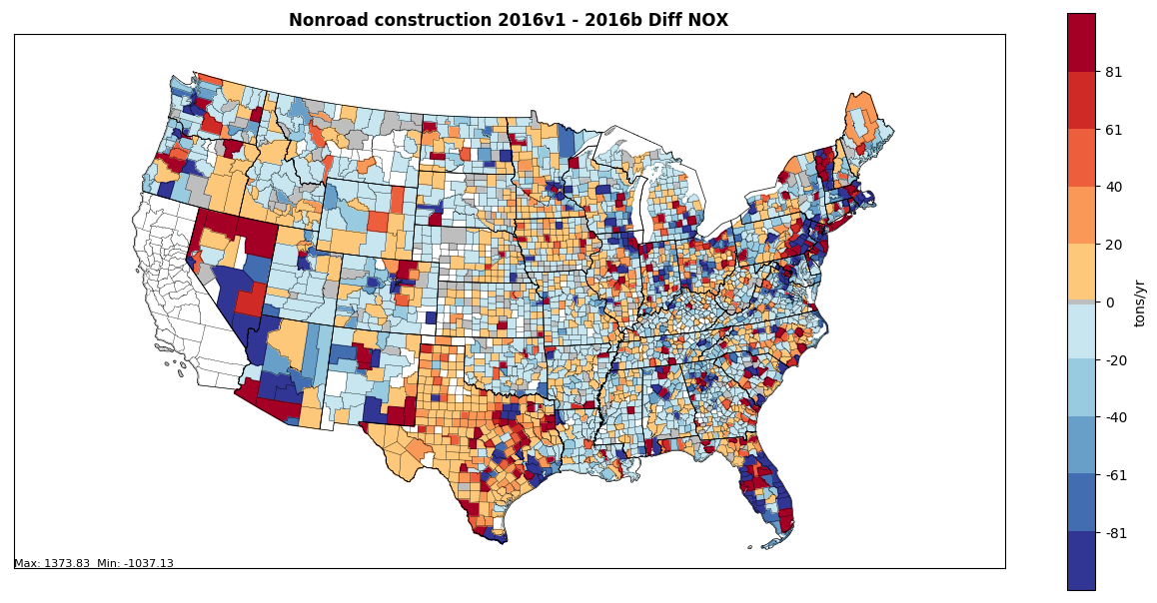
2016v1 Results: County-Level Emissions by Sector
Construction Sector
Difference (tons/year): 2016v1 – 2016beta (below)
Percent difference: 2016v1 - 2016beta (right)
Includes:
Updated equipment allocations (state- and county-level)
Updated temporal profiles and populations in Texas
Updated fuel formulation in Utah (still QAing) and Georgia

Slide 10
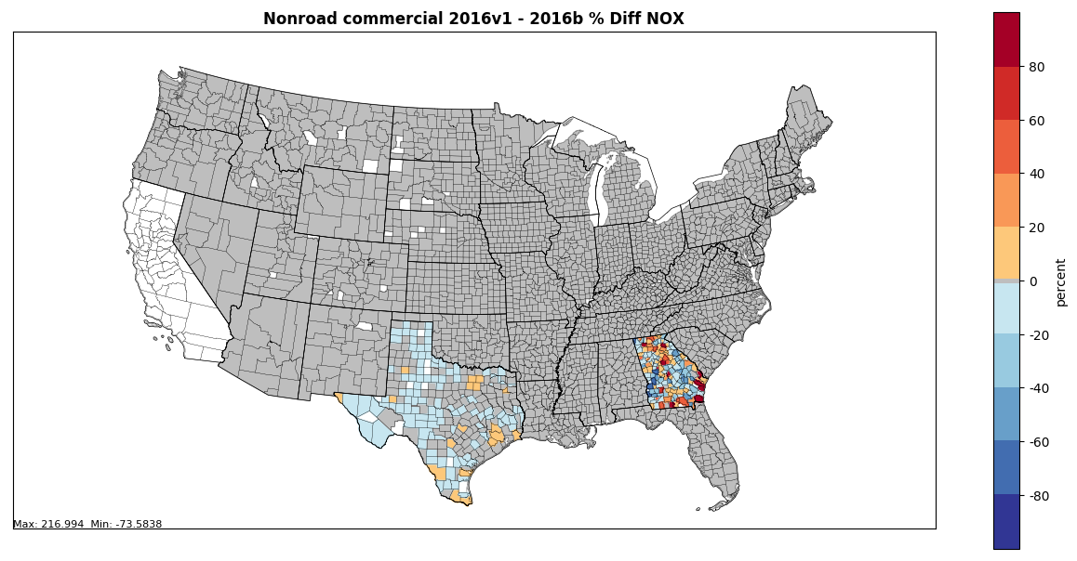
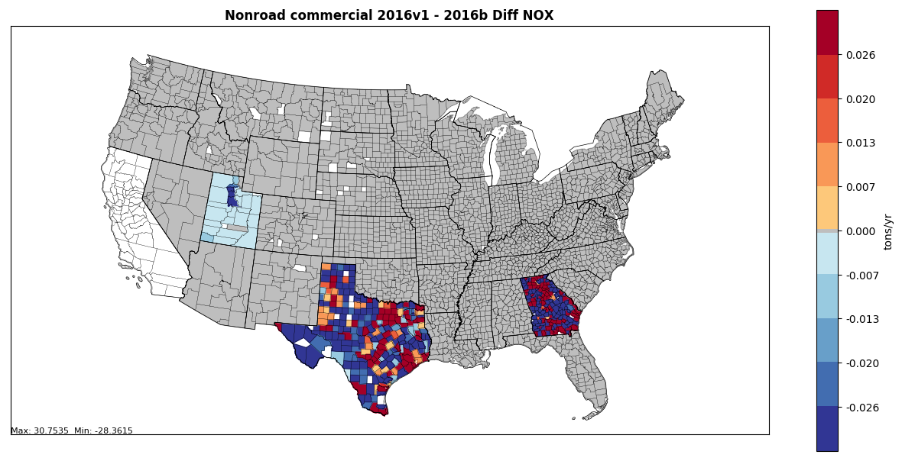
2016v1 Results: County-Level Emissions by Sector
Commercial Sector
Difference (tons/year): 2016v1 – 2016beta (below)
Percent difference: 2016v1 - 2016beta (right)
Includes:
Updated spatial allocations and fuel formulation in Georgia
Updated fuel formulation in Utah (still QAing)
Updated temporal profiles and populations in Texas

Slide 11
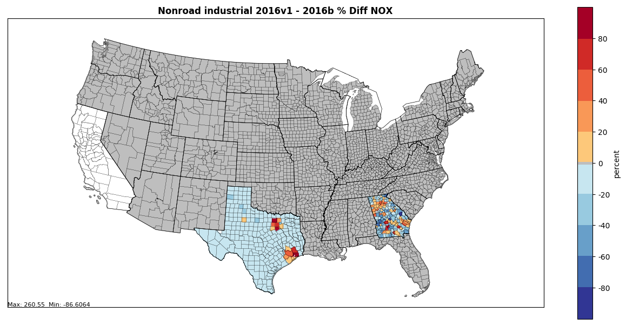
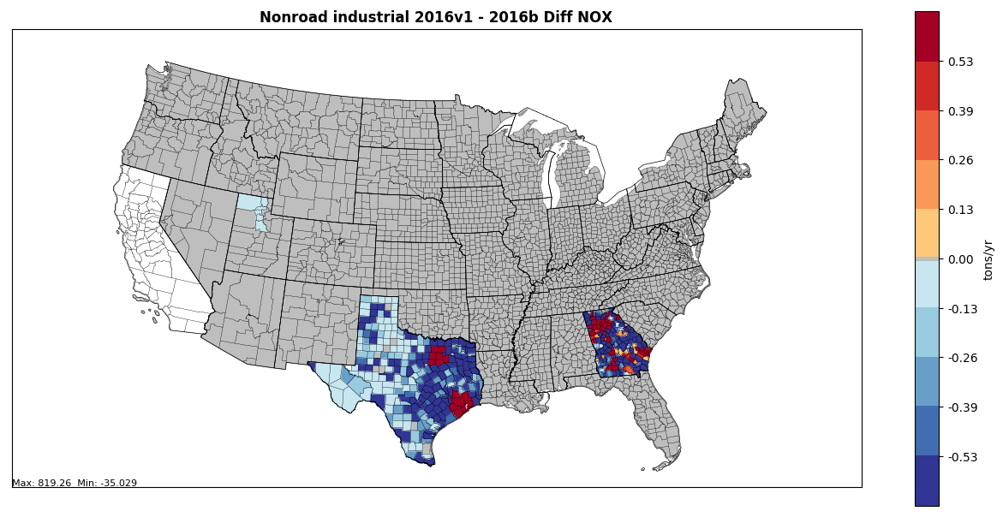
2016v1 Results: County-Level Emissions by Sector
Industrial Sector
Difference (tons/year): 2016v1 – 2016beta (below)
Percent difference: 2016v1 - 2016beta (right)
Includes:
Updated spatial allocations and fuel formulation in Georgia
Updated fuel formulation in Utah (still QAing)
Updated temporal profiles and populations in Texas

Slide 12
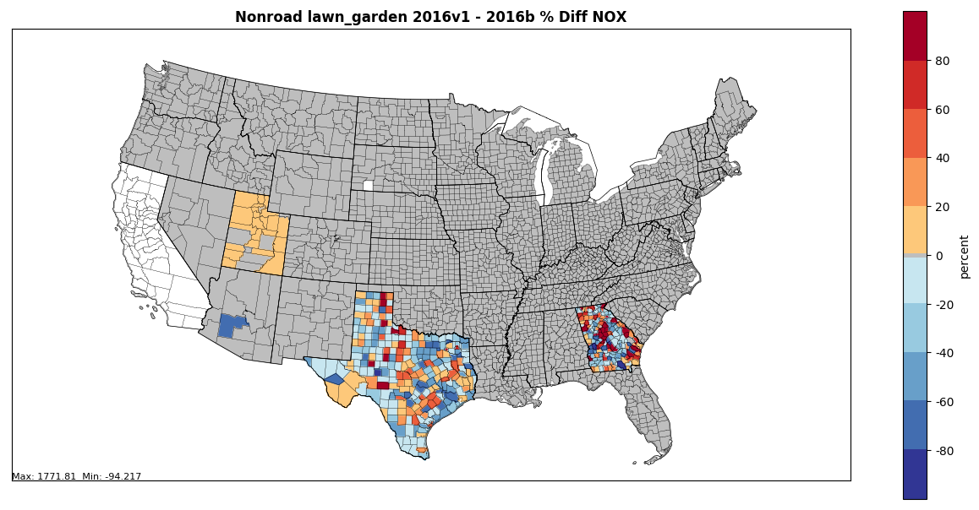
2016v1 Results: County-Level Emissions by Sector
Lawn & Garden Sector
Difference (tons/year): 2016v1 – 2016beta (below)
Percent difference: 2016v1 - 2016beta (right)
Includes:
Updated spatial allocations and fuel formulation in Georgia
Updated fuel formulation in Utah (still QAing)
Updated populations in Maricopa County
Updated temporal profiles and populations in Texas

Slide 13
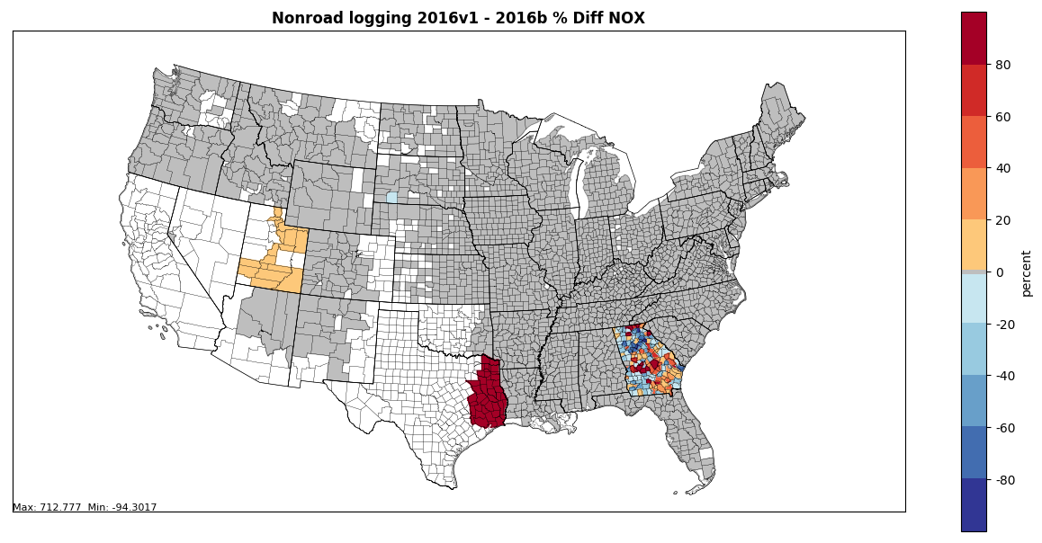
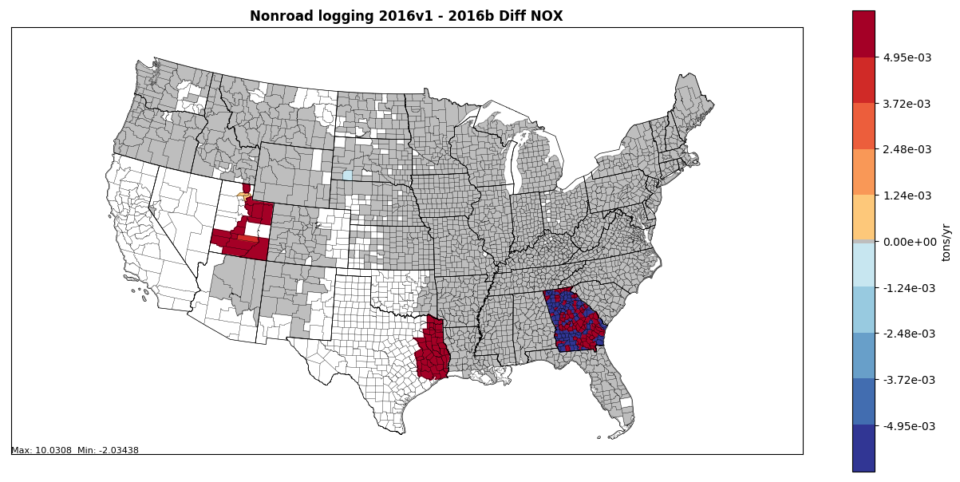
2016v1 Results: County-Level Emissions by Sector
Logging Sector
Difference (tons/year): 2016v1 – 2016beta (below)
Percent difference: 2016v1 - 2016beta (right)
Includes:
Updated spatial allocations and fuel formulation in Georgia
Updated fuel formulation in Utah (still QAing)
Updated temporal profiles and populations in Texas

Slide 14
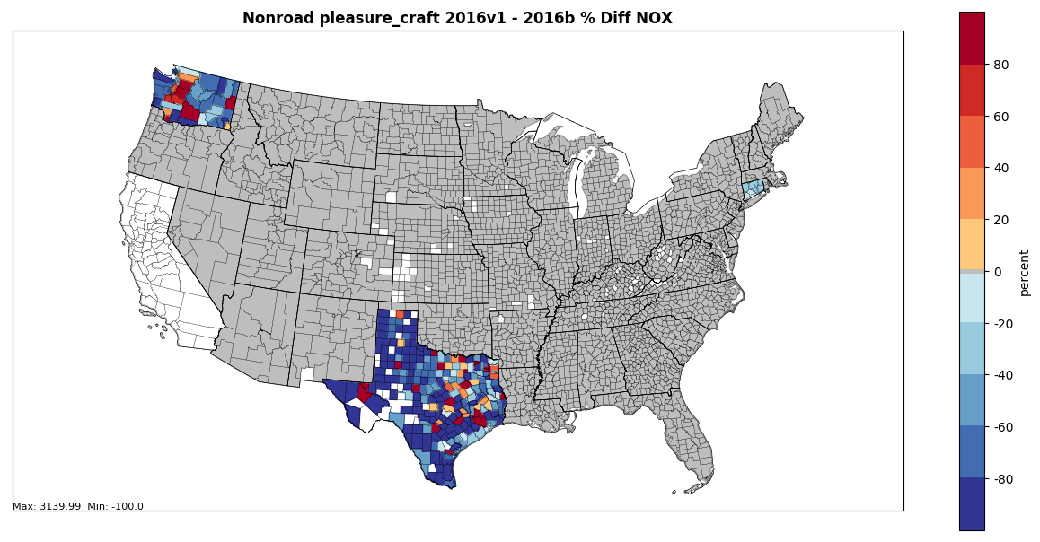
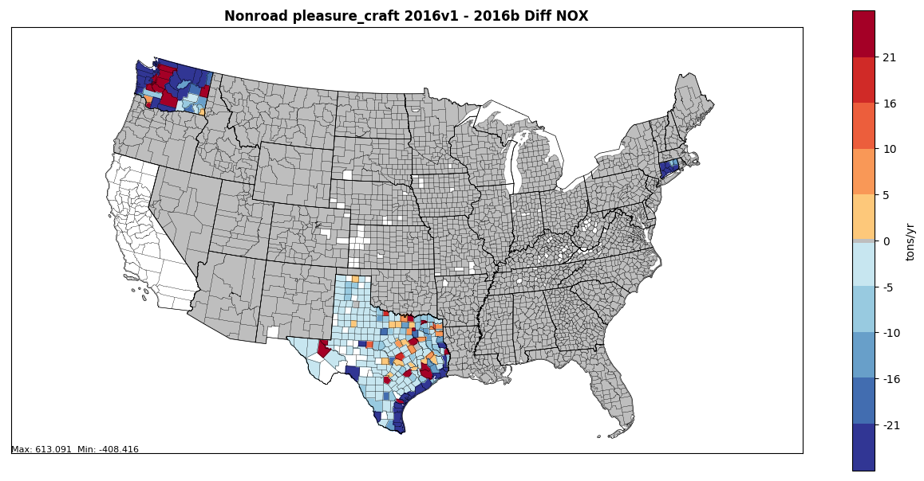
2016v1 Results: County-Level Emissions by Sector
Recreational Marine Sector
Difference (tons/year): 2016v1 – 2016beta (below)
Percent difference: 2016v1 - 2016beta (right)
Includes:
Updated spatial allocations in Washington
Updated populations in Connecticut
Updated temporal profiles and populations in Texas

Slide 15
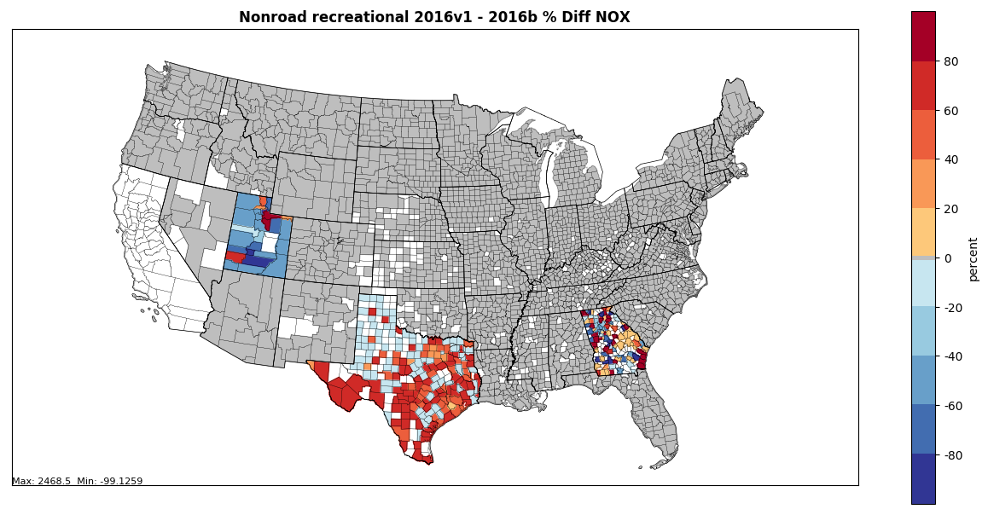
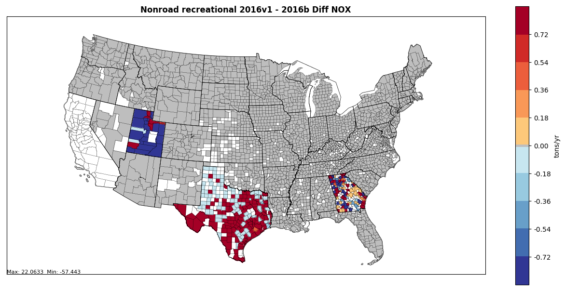
2016v1 Results: County-Level Emissions by Sector
Recreational Vehicles Sector
Difference (tons/year): 2016v1 – 2016beta (below)
Percent difference: 2016v1 - 2016beta (right)
Includes:
Updated spatial allocations and fuel formulation in Georgia
Updated snowmobile populations and month allocations in Utah
Updated fuel formulation in Utah (still QAing)
Updated temporal profiles and populations in Texas

Slide 16
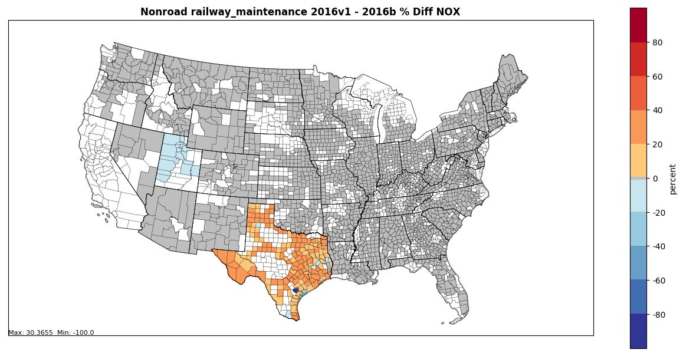
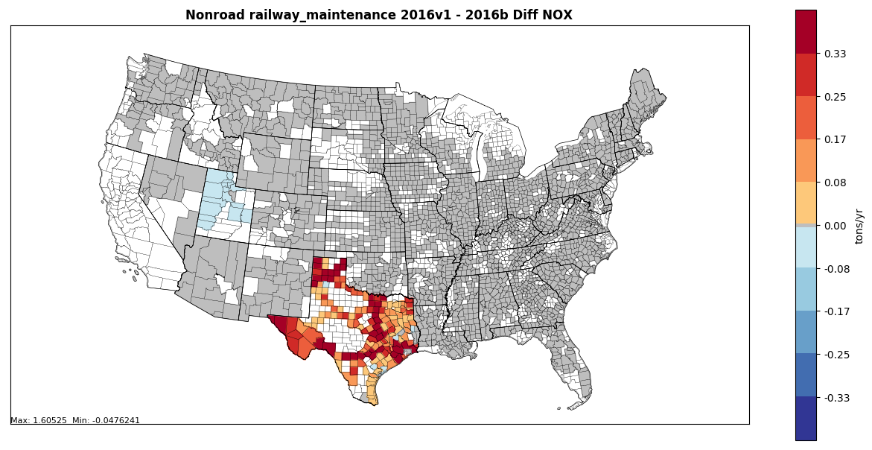
2016v1 Results: County-Level Emissions by Sector
Railway Maintenance Sector
Difference (tons/year): 2016v1 – 2016beta (below)
Percent difference: 2016v1 - 2016beta (right)
Includes:
Updated fuel formulation in Utah (still QAing)
Updated temporal profiles and populations in Texas

Slide 17
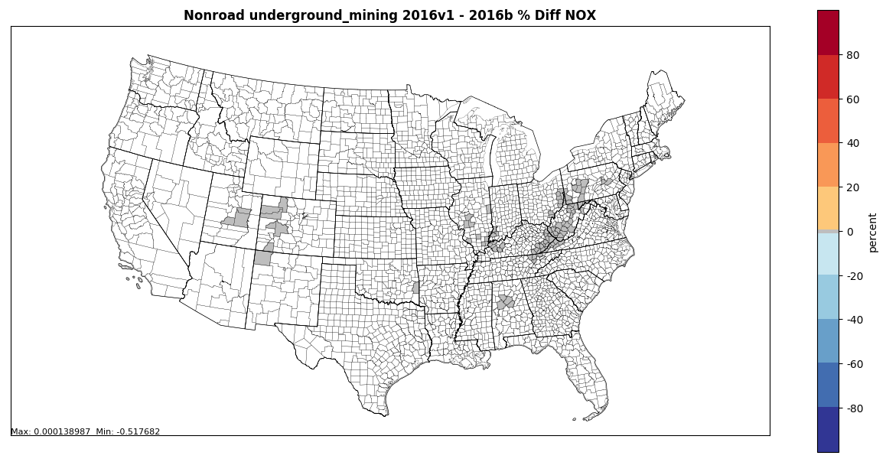
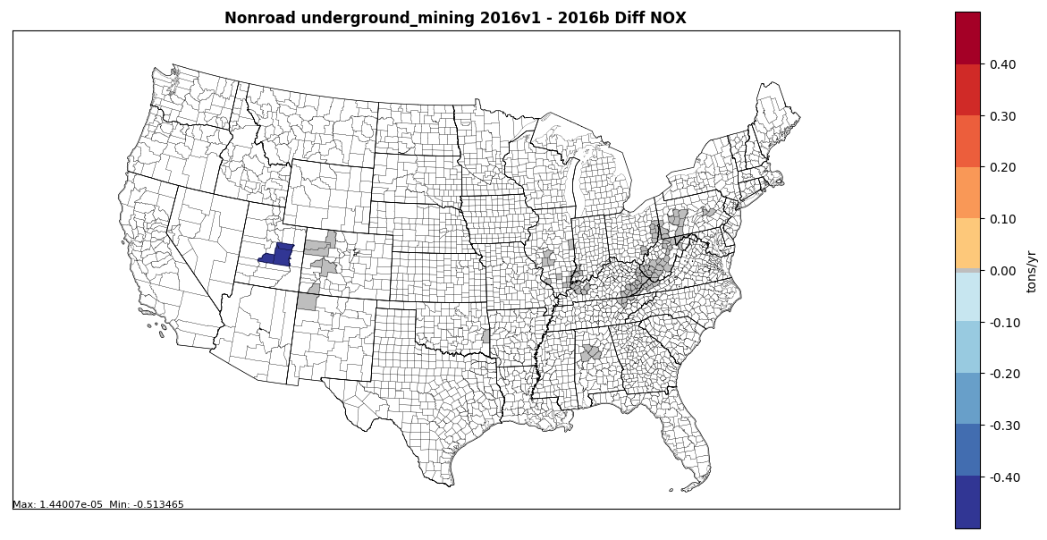
2016v1 Results: County-Level Emissions by Sector
Underground Mining Sector
Difference (tons/year): 2016v1 – 2016beta (below)
Percent difference: 2016v1 - 2016beta (right)
Includes:
Updated fuel formulation in Utah (still QAing)

Slide 18
Discussion/Next Steps/Reminders
Discussion/questions
Next steps:
All: review and provide comment on 2016v1 summaries for CY2016
EPA: kick-off future year nonroad runs in July/early August; start compiling 2016v1 documentation
EPA: incorporate TexN emissions
Accessing emissions summaries, county plots, and other information:
2016 v1 emission summaries and maps: ftp://newftp.epa.gov/air/emismod/2016/v1/reports/nonroad/
2016 beta summary files on Google Drive: https://drive.google.com/drive/u/0/folders/1yFEmYlWgcjKkeS48UQ0SerYZdpTY0oEm
Work Group meeting minutes and related files and links available on Work Group wiki: http://views.cira.colostate.edu/wiki/wiki/9179
Next meeting: TBD (likely August, following completion of future year runs)

